Slide 1


AI-Based Personal Finance Advisor

Slide 2


1. Company Overview
Company Details
Company: Tinos Software and Security Solutions LLP
Interns:
Mohammed Sinaan P. K
Jishnu P. B
Mentor: Muhammed Faez
Internship Duration:
Jishnu P. B
15 July 2025 – 30 Oct 2025
Mohammed Sinaan P. K
10 Sept 2025 – 10 Dec 2025

Slide 3

2. Introduction
Managing personal finances is often challenging as people receive many unstructured SMS alerts from banks.
Manual tracking is time-consuming and prone to errors.
This project develops an AI-Based Personal Finance Advisor that automatically extracts, categorizes, and analyzes transactions from SMS messages.
It provides clear spending insights and recommendations through an interactive dashboard, helping users make better financial decisions.

Slide 4


3. Problem Statement
People receive numerous SMS alerts from banks but rarely analyze or track them.
Lack of categorization (Food, Shopping, Bills, etc.) makes budgeting difficult.
Manual tracking is tedious and error-prone.
Need for an AI-powered automated advisor to interpret financial SMS data and provide insights.

Slide 5




4. Objectives
1
2
Automatically extract and classify transactions from SMS messages.
Categorize expenses into Food, Shopping, Bills, etc.
3
4
Generate spending analytics and summaries.
Build an interactive dashboard for visualization and financial insights.

Slide 6
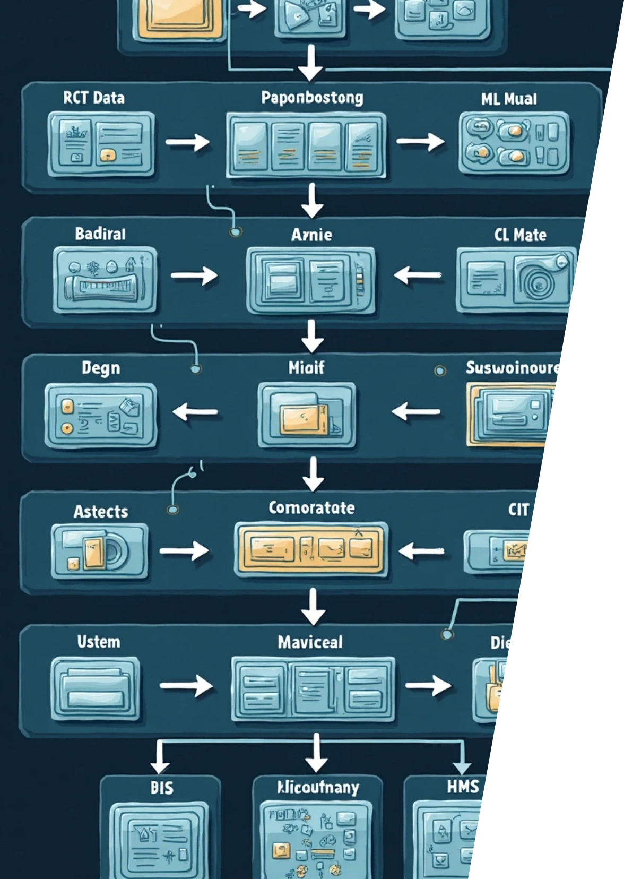
5. Architecture
Flow:
SMS Data → Preprocessing → Parsing → Categorization → ML Model → Visualization (Dashboard)
Input: Transactional SMS dataset (from users or banks).
Processing: Text cleaning, keyword extraction, classification logic.
Output: Expense reports, charts, spending summaries, and categorized transactions.

Slide 7


6. Data Collection & Preprocessing
Dataset Source: Synthetic + Real Bank SMS Data
Preprocessing Steps:
1
Lowercasing, punctuation removal, normalization.
2
Handling “Other” and “Unknown” categories.
3
Added realistic examples (Food, Shopping, Bills).

Slide 8

7. Machine Learning / Classification Logic
Approach: Keyword-based + rule-driven classification.
Categories: Food, Shopping, Bills, and Other.
Logic Example:
if "debited" in sms: return "Debit" elif "credited" in sms: return "Credit" else: return "Unknown"
Future Upgrade: Integrate NLP models like BERT or GPT-based fine-tuning for improved accuracy and semantic understanding.

Slide 9
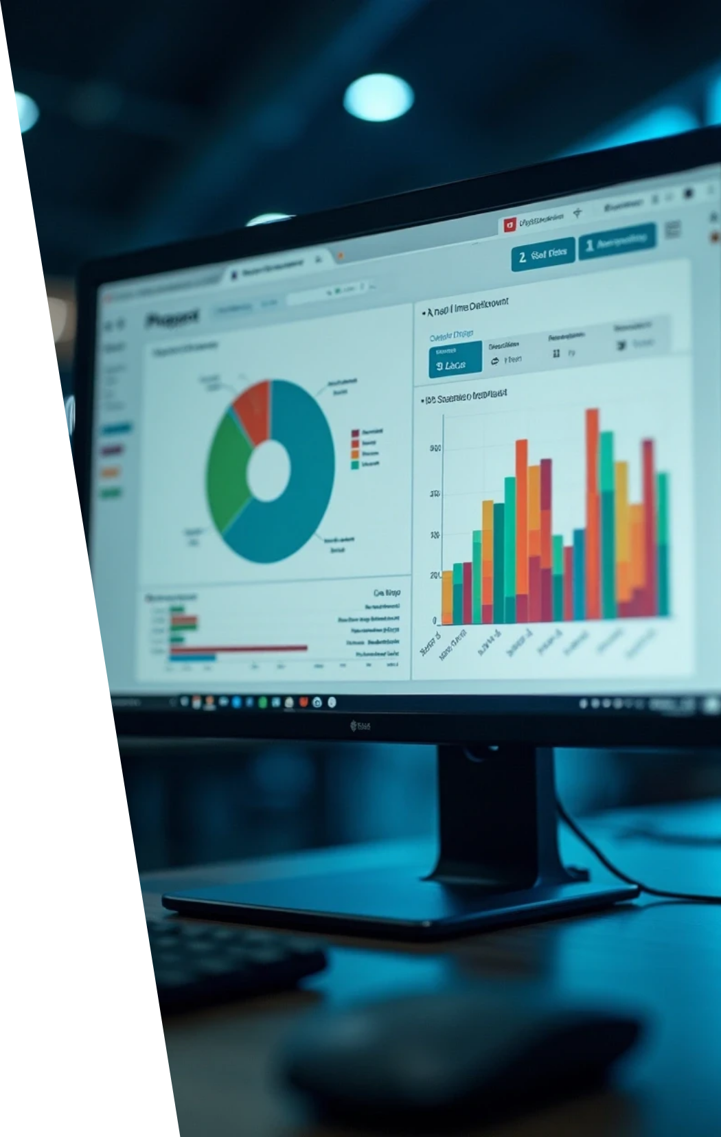

8. Implementation
Programming Language: Python
Libraries & Tools: Pandas, Regex, Matplotlib, Plotly, Streamlit
Framework: Streamlit (for interactive dashboard visualization)
Features:
1
Upload SMS dataset (CSV format).
2
Automatic expense categorization.
3
Real-time charts for spending breakdown and category insights.

Slide 10
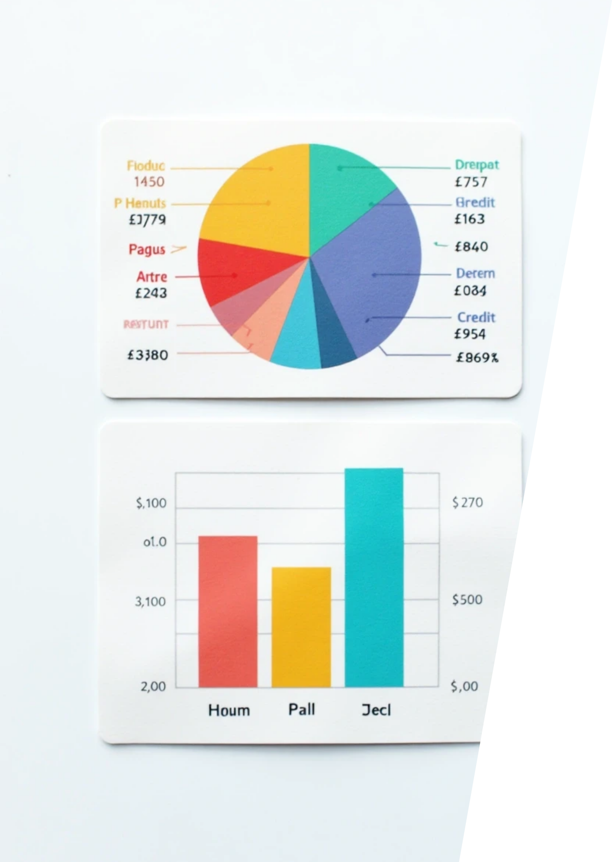

9. Results & Visualization
Outputs:
Pie chart showing category-wise spending.
Bar chart comparing Debit vs Credit totals.
Example Insights:
Food
₹8.8M
Shopping
₹5.2M
Bills
₹12K
Improvement: “Other” category reduced, improving model interpretability and accuracy.

Slide 11
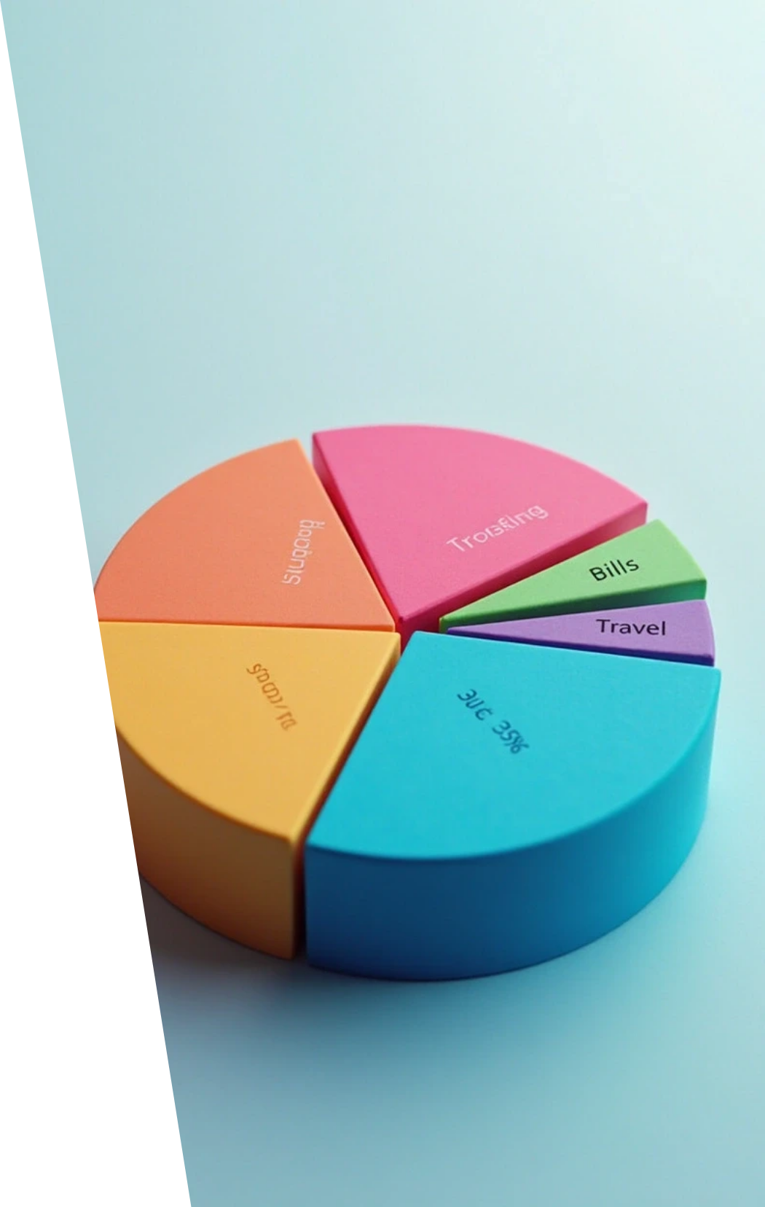





10. Insights & Analysis
1
2
Food dominates total spending
Shopping accounts for \~30–35% of expenses.
3
4
Bills and categories have smaller shares.
Users can easily detect overspending patterns and plan budgets effectively.

Slide 12



11. Future Enhancements
Integrate AI chatbot for personal finance advice.
Add automated budget planning suggestions.
Connect with real-time banking APIs securely.
Replace keyword rules with advanced NLP/ML models for dynamic classification.

Slide 13
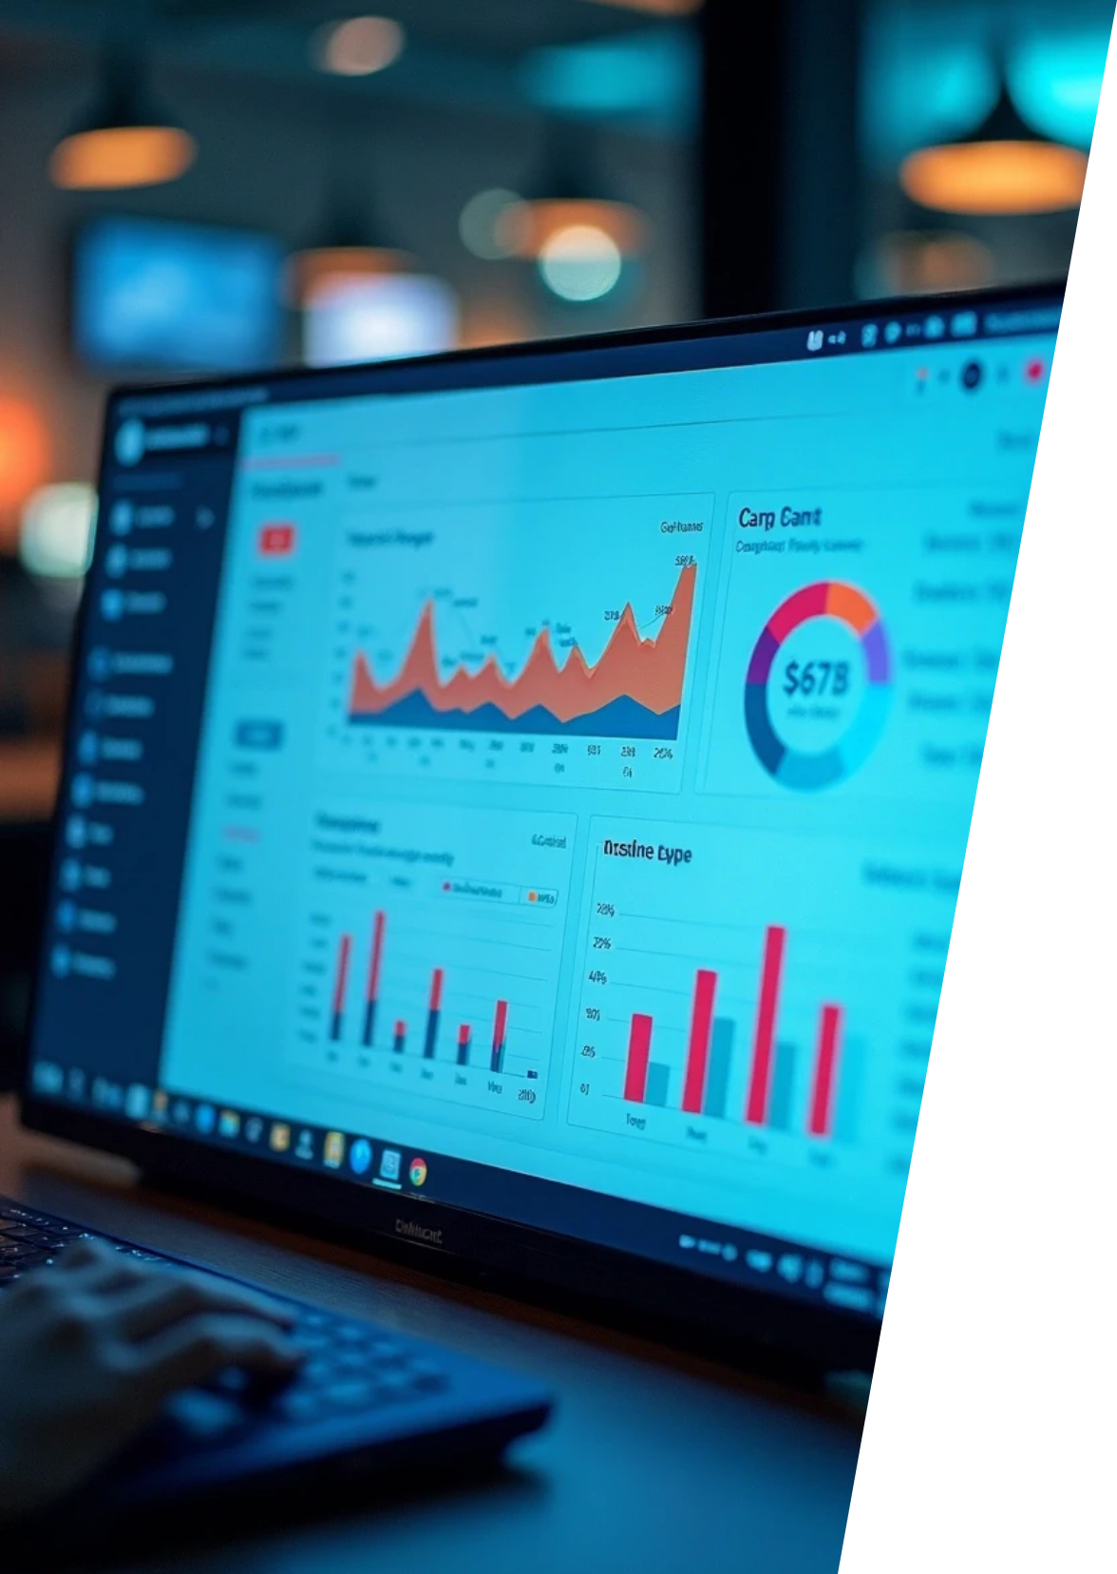




12. Conclusion
1
Successfully developed an automated AI system to extract and analyze SMS-based financial data.
2
Built an interactive visualization dashboard using Streamlit.
3
Helps users make data-driven financial decisions through categorized insights and analytics

Slide 14

Thank You

